Slide 1
Fully Convolutional Networks
Alex, 2020.06.08
Fully convolutional networks for semantic segmentation

Slide 2
Outline
What is Semantic Segmentation ?
Introduction to FCN
Several Key Technologies of FCN
Semantic Segmentation of FCN
Summary of the FCN Model

Slide 3
01
What is Semantic Segmentation ?

Slide 4
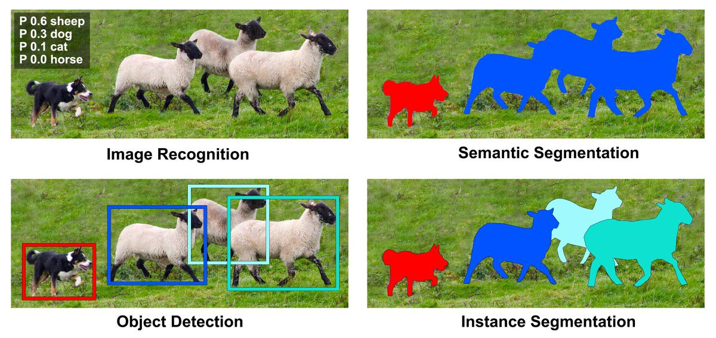
What is semantic segmentation ?

Slide 5
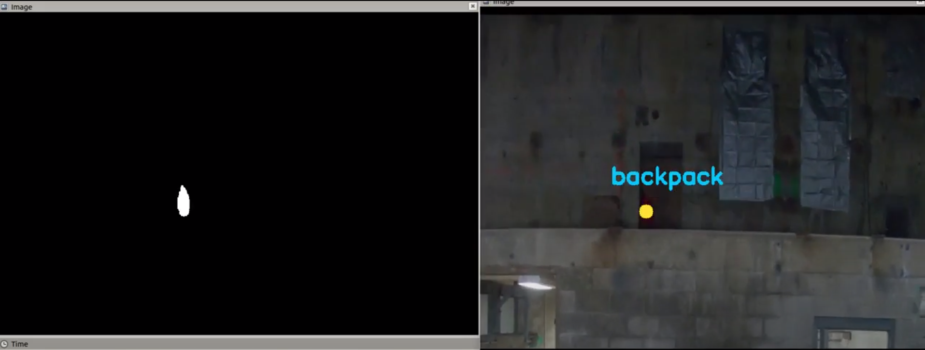
FCN for Artifact Search

Slide 6
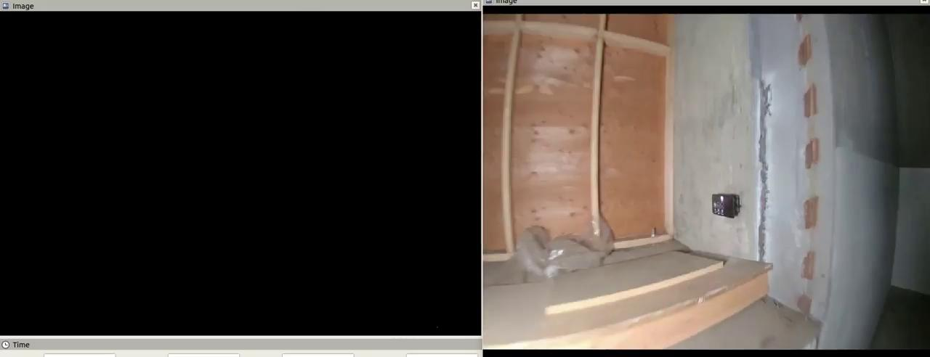

Slide 7
02
Introduction to FCN

Slide 8
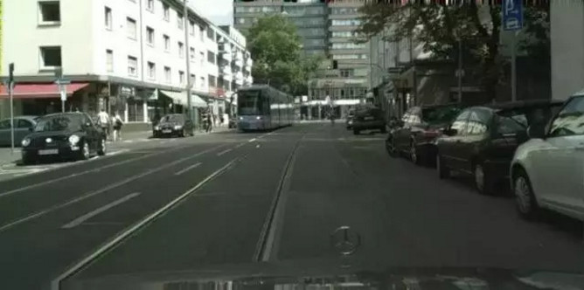
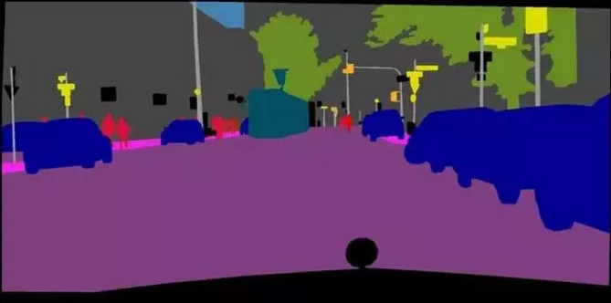
FCN
Paper published by Jonathan Long in 2015. (cite 15306）
The output is a mask picture.
Semantic segmentation.

Slide 9
Comparison of CNN and FCN
CNN (Convolutional Neural Network)
FCN (Fully Convolutional Networks)
Usually CNN maps the feature map generated by the convolutional layer into a fixed-length feature vector.
The output is the probability that the image belongs to each category.
FCN replaces CNN's last fully connected layer with a convolutional layer.
The output is a picture that has been labelled.

Slide 10
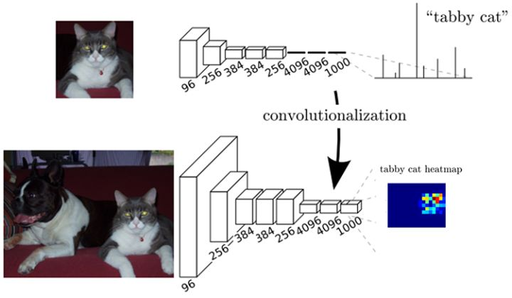
Comparison of CNN and FCN

Slide 11
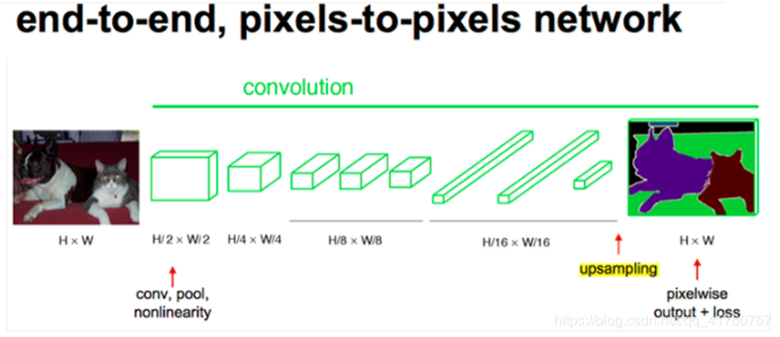
Comparison of CNN and FCN

Slide 12
03
Several Key Technologies of FCN

Slide 13

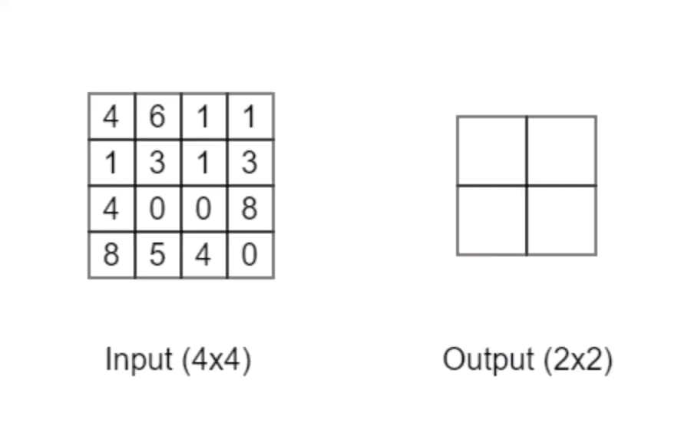
Convolution & Pooling

Slide 14
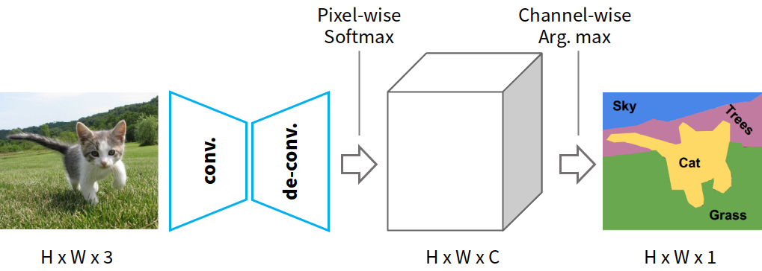
Algorithm Architecture
Convolution
Upsampling (Deconvolution)
Skip layers

Slide 15
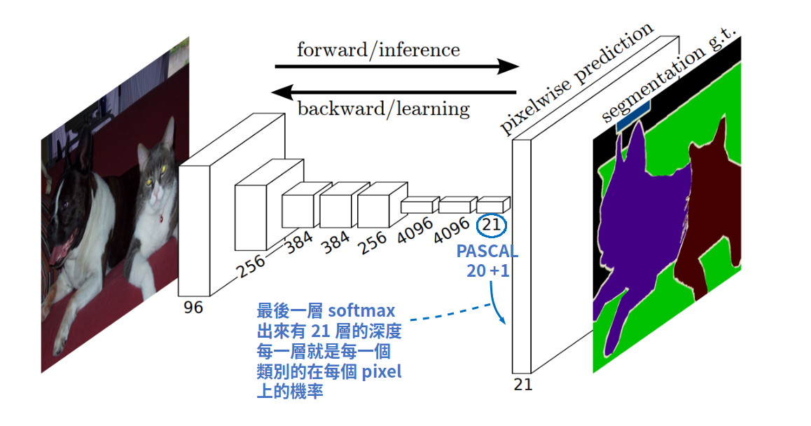
Fully convolutional
Fully convolutional network means that the final classification layer is changed from the original fully connected layer to a convolutional layer.
PASCAL VOC is 20 categories + background, so it is 21.

Slide 16
Upsampling (Deconvolution)
Because of the continuous dimensionality reduction of the convolutional network, the image is reduced from the original dimension to 1/32.
To restore to the original size, the final output of the convolutional network is enlarged back, that is, upsampling

Slide 17


Upsampling (Deconvolution)
Convolution
Deconvolution

Slide 18
Skip layers strategy
In a forward convolutional network, the image dimension is gradually reduced along with many stages of pooling.
However, now FCN wants to enlarge the prediction map of a small size.If you directly zoom back from the smallest prediction map, the result will be very poor.
These feature maps that are gradually pooling need to be taken into account when zooming in, so that the process of zooming in can combine the features of different scales to obtain finer results.

Slide 19
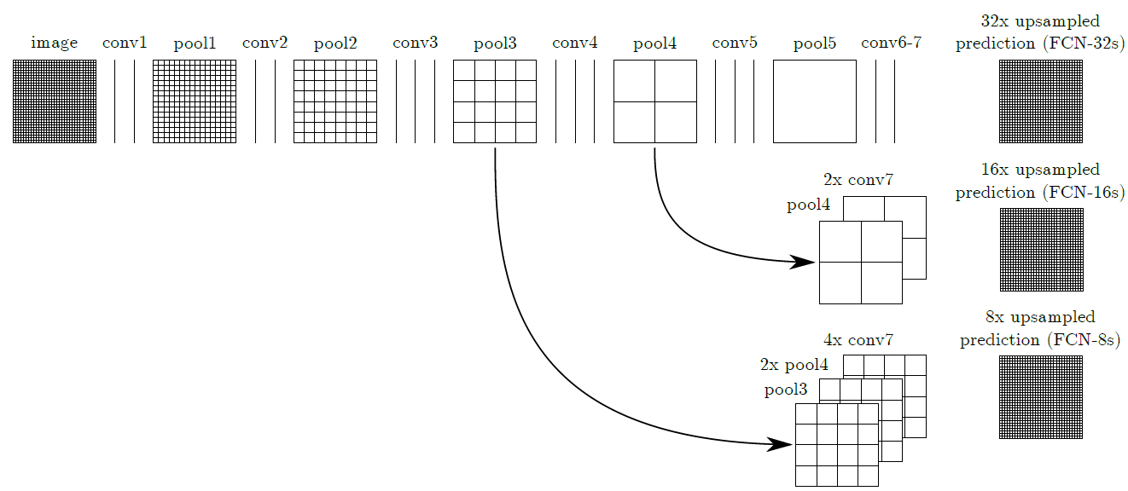
Skip layers strategy

Slide 20
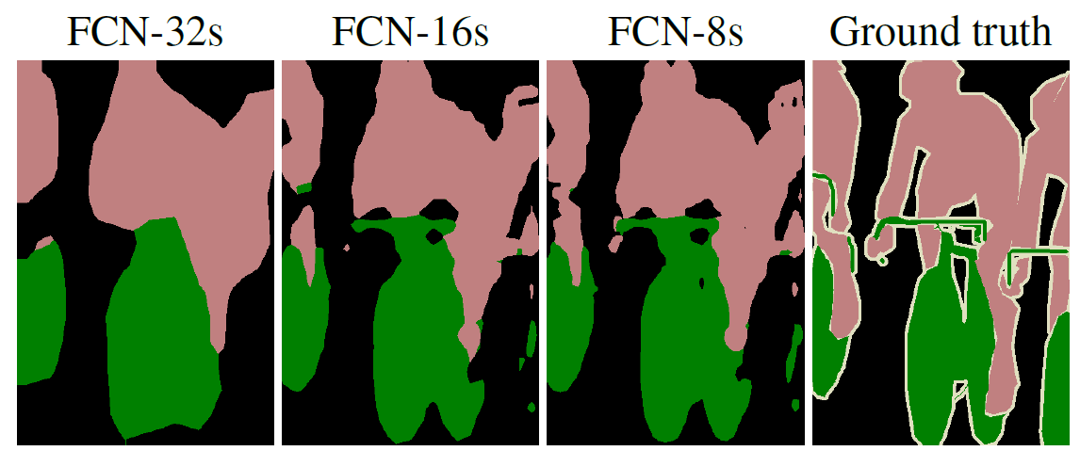
Result
The finer the final prediction map obtained by considering more feature maps of different scales, the higher the fineness and the closer to ground-truth.

Slide 21
04
Semantic Segmentation of FCN

Slide 22
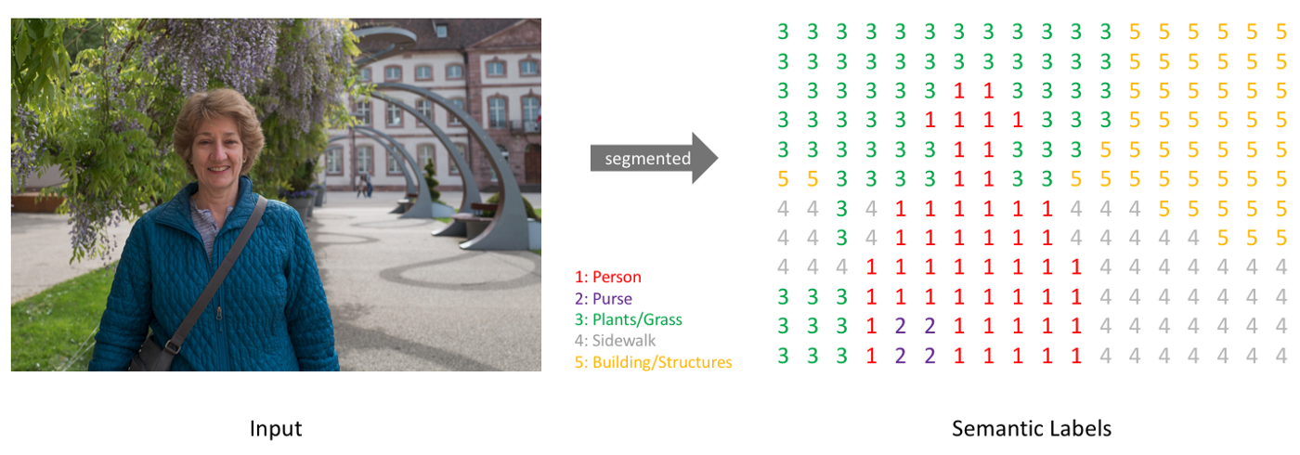
Prediction Map of Semantic Segmentation
There are items corresponding to each pixel in the predict map.

Slide 23
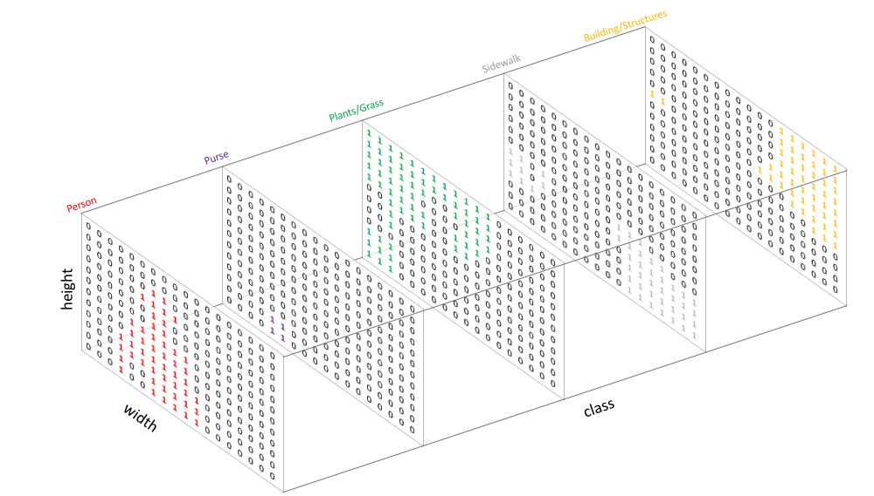
Prediction Map of Semantic Segmentation

Slide 24
Prediction Map of Semantic Segmentation
After calculating the softmax probability of the category classification of each pixel, FCN will take the maximum probability of channel-wise, and use the channel where the maximum probability is as the category of the pixel at that location.

Slide 25
05
Summary of the FCN Model

Slide 26
Summary of the FCN Model
The convolutional network part of FCN can use VGG, GoogleNet, AlexNet, etc. as the pre-base network.
If you want to accurately predict the segmentation result of each pixel, you must go through two processes from large to small, and then from small to large.
In the upsampling process, it is better to increase in stages rather than in one step.
At each stage of upsampling, use the features of the corresponding layer of downsampling to assist.

